Slide 1
COS 212 Hashing

Slide 2
The problem of searching
 | Average case |  |  | Worst case
 | search | insert | delete | search | insert | delete
Unsorted array | O(n) | O(n) | O(n) | O(n) | O(n) | O(n)
Sorted array | O(lg n) | O(n) | O(n) | O(lg n) | O(n) | O(n)
Unsorted linked list | O(n) | O(1) | O(1) | O(n) | O(1) | O(1)
Sorted linked list | O(n) | O(1) | O(1) | O(n) | O(1) | O(1)
Skip list | O(lg n) | O(1) | O(1) | O(n) | O(1) | O(1)
BST | O(lg n) | O(lg n) | O(lg n) | O(n) | O(n) | O(n)
B-Tree | O(lg n) | O(lg n) | O(lg n) | O(lg n) | O(lg n) | O(lg n)
What if we invented a function that, given the object key, can instantly calculate the index of the object?

Slide 3
Hash functions
Basic idea: Save items in a key-indexed table (index is a function of the key)
Hash function: Method for computing table index from key
What is the search complexity if the index can be instantaneously derived from the object key?
O(1)
The holy grail: you can’t do better
What we want from a hash function:
Easy to compute
No collisions
K
index
key K
h(K)
hash(“James”) = 2
hash(“Jane”) = 2
?
0 | 1 | 2 | 3 | 4 | 5 | 6

Slide 4
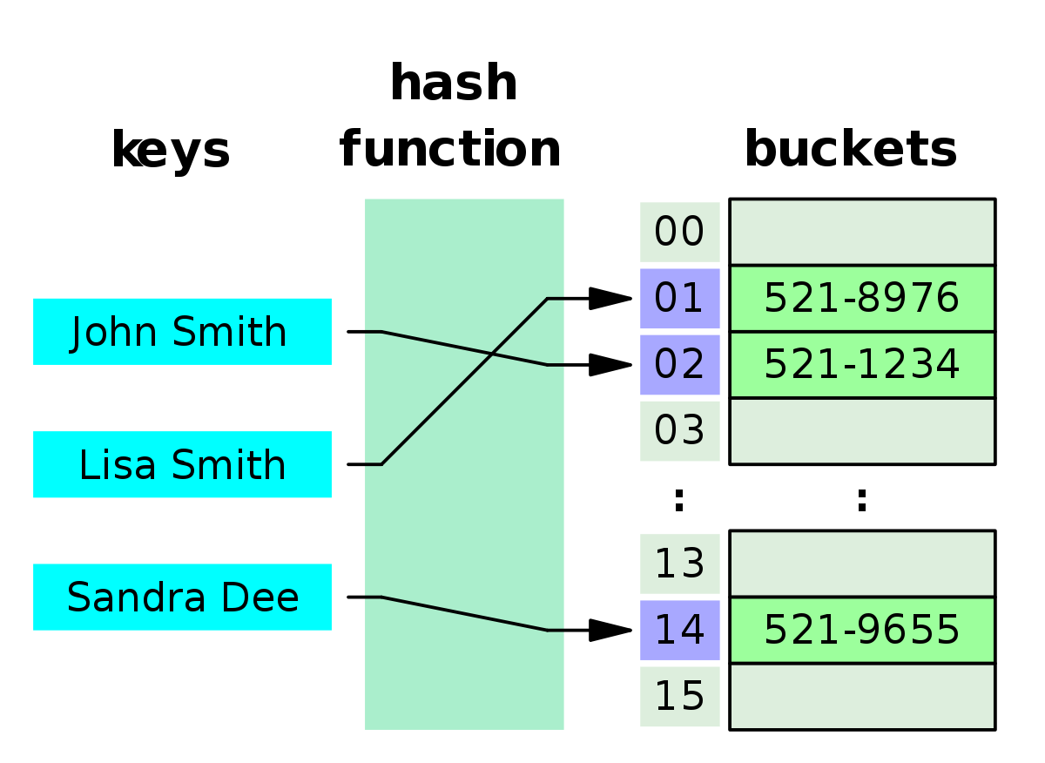
Hash table (hash map)
Array-like data structure: associative array
Maps keys to indexes associated with values
A hash function is used to compute the index of each key

Slide 5
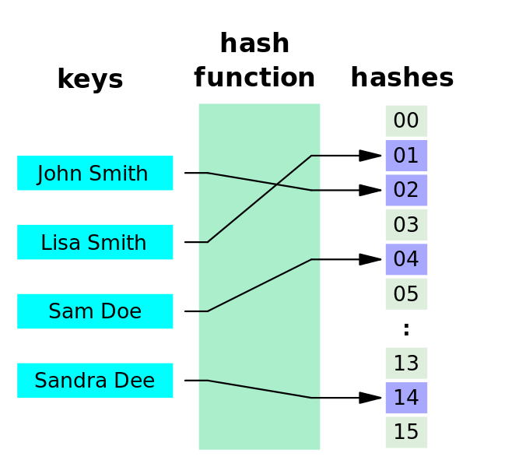
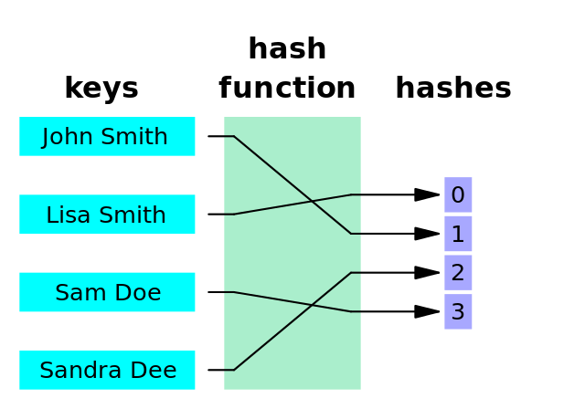
Hash functions
What makes a good hash function?
It must be easy (efficient!) to calculate
Each index is equally likely to be generated for each key
A hash function where every key gets a different hash value is a perfect hash function
Example: how would you hash phone numbers?
Bad hashing: use first three digits (shared area codes)
Better hashing: use last three digits (unique extension)
Neither is perfect
Perfect Hashing
Minimal Perfect Hashing

Slide 6
Hash functions: Extraction
Use a selection of digits as the key
Eg, use the first three digits; or the last three; or first, last, and middle
Choice of the appropriate subset depends on the application
Part of the key that is least likely to repeat should be chosen
This hashing function is extremely simple => efficient!
Disadvantage: part of the key is used -> less variation
15351871
15001226
871
226
What assumption are we making by extracting 3 digits?

Slide 7
Hash functions: Division
Suppose the size of the hash table is T
The indices generated by the hash function must be in [0, T - 1]
If key K is numeric (or interpreted as such):
hash(K) = K % T
Remainder (modulus) operator will return values in the desired range
0
1
2
3
4
5
6
7
8
9
33
16
27
25
18
1
72
The size of the table is 10
Now suppose the majority of your keys end in a 0
Collisions everywhere!
Division hashing works best for T = large prime number
Alternatively:
hash(K) = (K % p) % T
p = prime number > T
h(K) = K % 10

Slide 8
Hash functions: Folding
Designed to increase variability of hash codes
Split the key into equal parts
Combine the parts using a simple operation such as addition
Apply division hashing to restrict the index to the desired range
Shift folding:
Boundary folding:
15351871
15 + 35 + 18 + 71 = 139
139 % T
15351871
15 + 53 + 18 + 17 = 103
103 % T

Slide 9
Hash functions: Mid-Square Function
Square the key
Use the middle section of a desired length as the hash value
Advantage: the entire key is used -> more variation
Hash functions can be combined: apply folding first, followed by mid-squaring
To simplify calculation: perform the same procedure on binary representations; logic operations alone (shifting & masking) can accomplish the task
15351871
15001226
235679943200641
225036781503076
943
781

Slide 10
Hash functions: Radix Transformation
Convert the numeric key to another base
Eg, convert decimal to octal
Apply division hashing to restrict the index to the desired range
Can increase variation
Can be prone to collisions:
(2560)₁₀ = (5000)₈
(2048)₁₀ = (4000)₈
15351871
15001226
72440077
71163212
72440077 % T
71163212 % T

Slide 11
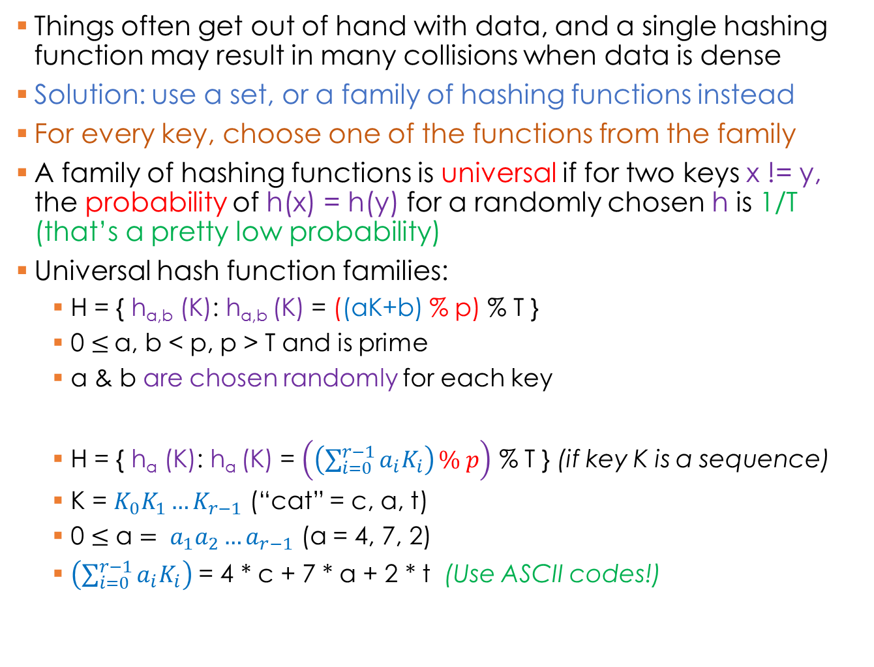
Hash functions: Universal Hashing
Things often get out of hand with data, and a single hashing function may result in many collisions when data is dense
Solution: use a set, or a family of hashing functions instead
For every key, choose one of the functions from the family
A family of hashing functions is universal if for two keys x != y, the probability of h(x) = h(y) for a randomly chosen h is 1/T (that’s a pretty low probability)
Universal hash function families:
H = { h_{a,b} (K): h_{a,b} (K) = ((aK+b) % p) % T }
0 $≤$a, b < p, p > T and is prime
a & b are chosen randomly for each key
H = { h_{a} (K): h_{a} (K) = $\left.\left(\left(\sum_{i=0}^{r−1}{a_{i}K_{i}}\right)\right.\% p\right)$ % T } (if key K is a sequence)
K = $K_{0}K_{1}…K_{r−1}$ (“cat” = c, a, t)
0 $≤\text{a}= a_{1}a_{2}…a_{r−1}$ (a = 4, 7, 2)
$\left(\sum_{i=0}^{r−1}{a_{i}K_{i}}\right)$ = 4 * c + 7 * a + 2 * t (Use ASCII codes!)
If a and b are random, how are we going to find the key after it is stored?

Slide 12
Hash functions: Hashing strings
Strings are not numbers – how are they to be hashed?
Use ASCII codes!
Concatenate the ASCII codes:
Adding the values would have resulted in a collision:
82 + 79 + 83 + 69 = 83 + 79 + 82 + 69
Even more efficient:
Treat strings as binary
Treat binary as integers
ROSE
SORE
82, 79, 83, 69
83, 79, 82, 69
82798369 % T
83798269 % T

